Slide 1

Web Scrapping Seloger.com for Roubaix and Tourcoing
By : Omar Abdelgelil
Individual Python Project : Professor Minh Phan

Slide 2
01
Content
DATA COLLECTION
02
DATA CLEANING & Variable Creation
03
DATA VISUALIZATION
Insights and Recommendations
04

Slide 3
01
DATA COLLECTION

Slide 4
Timeline Style
2/01/2020
Data was scrapped from seloger.com on this day. The search engine did output 43 pages with around 1000 house units for the two cities

Slide 5
What is the Data Collected ?
Name Here
Name Here
Programmer
Programmer
After Browsing through the website, I wanted to web scrap five kind of information:
Type: Whether the unit offered is an apartment or Maison/Villa
Area: It showed how many rooms does the house contains as well as it’s size in m2
TotalPrice: shows the entity’s total price in Euros
MonthlyPrice: Shows the amount of money you will need to pay per month to buy the house in Euros
Address: Shows the city (Roubaix or Tourcoing) and the remaining part of the address if available
Name Here
Designer

Slide 6
Web Scrapping coding structure
6- Exported the dataframe into an excel sheet
1- Web Scrapped using selenium and Chrome Web driver
5- converted the dictionary into a dataframe
2- Created 5 lists one for each kind of info I am scrapping to save the results in
3- Modified the url by looping through the link and modify the last part of it which corresponds to different pages on the website
4- Appended all the created lists into a dictionary

Slide 7
02
DATA CLEANING & Variable Creation

Slide 8
Which Data needed to be cleaned and from which variables are created?
01
ADDRESS
I splitted the data in the address column into two columns. A column called City which indicates whether the unit is in roubaix or Tourcoing. And a column called AddressName which hold the remaining part of the address. We can see from here that 40 units didn’t have extra address info
02
AREA
Created a new column called Size from the Area column which takes just the units size in m2, and there we can see that there is 11 units where the size was missing. Those 11 NA values were replaced by 0 for further analysis and visualization requirements.
03
MonthlyPrice
Clean the MonthlyPrice column by removing the “**” at the end

Slide 9
Which Data needed to be cleaned and from which variables are created?
04
SIZE
Created a size_group variable that groups size together for every 10 m2 range, for example
any unit which has a size from 50 m2 to 60 m2 will be grouped as 50
05
TOTALPRICE
Created a totalPrice_group variable that groups totalPrice together for every 100 000 euros range, for example
any unit which has a price from 100 000 euro to 200 000 euros will be grouped as 100 000

Slide 10
03
DATA Visualization

Slide 11
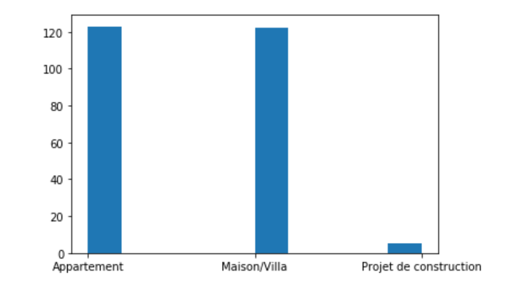
Type of Units offered for Sale
We can see that in general there is more apartments to buy than Maison/Villas and very few units under construction

Slide 12
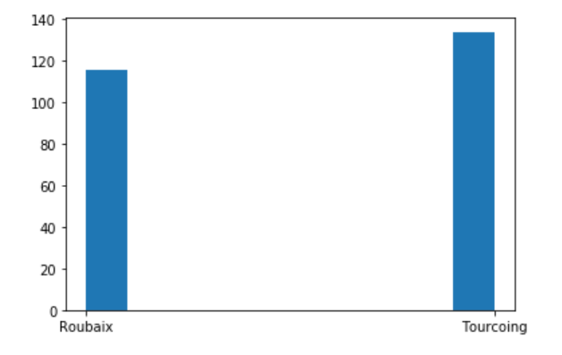
Which City offers more Units ?
More units are offered in Tourcoing compared to Roubaix

Slide 13
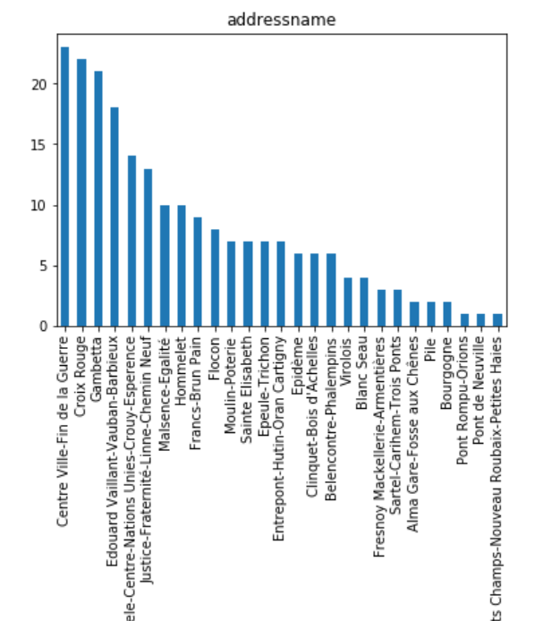
Most Address Part where Units are offered
Most Units are found in Centre Ville-Fin de la Guerre

Slide 14
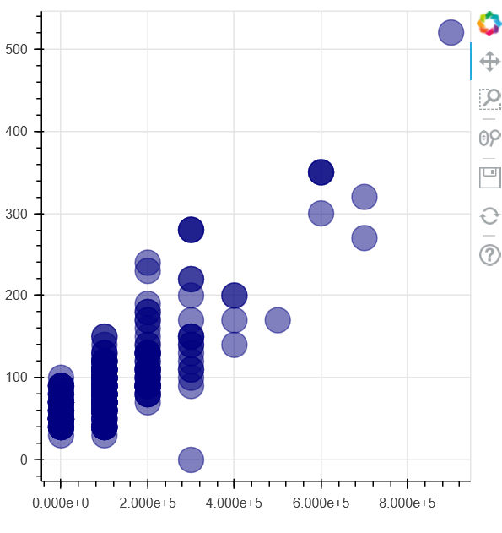
Units Size Vs Price Correlation
The Units Size and Price is Positvely correlated. The Bigger the size, the higher is the price.

Slide 15
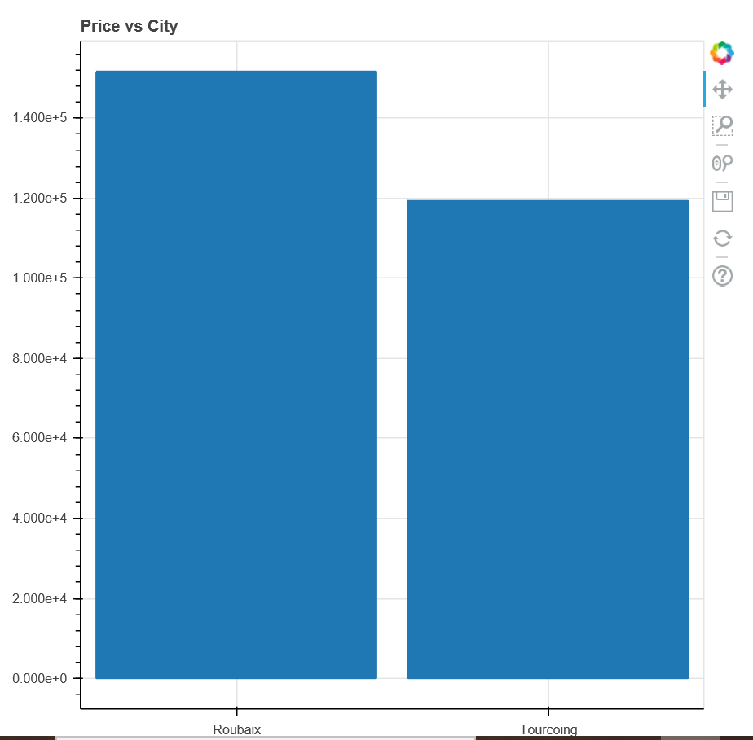
Which City is More expensive ?
Prices in Roubaix are higher than Tourcoing on Average

Slide 16
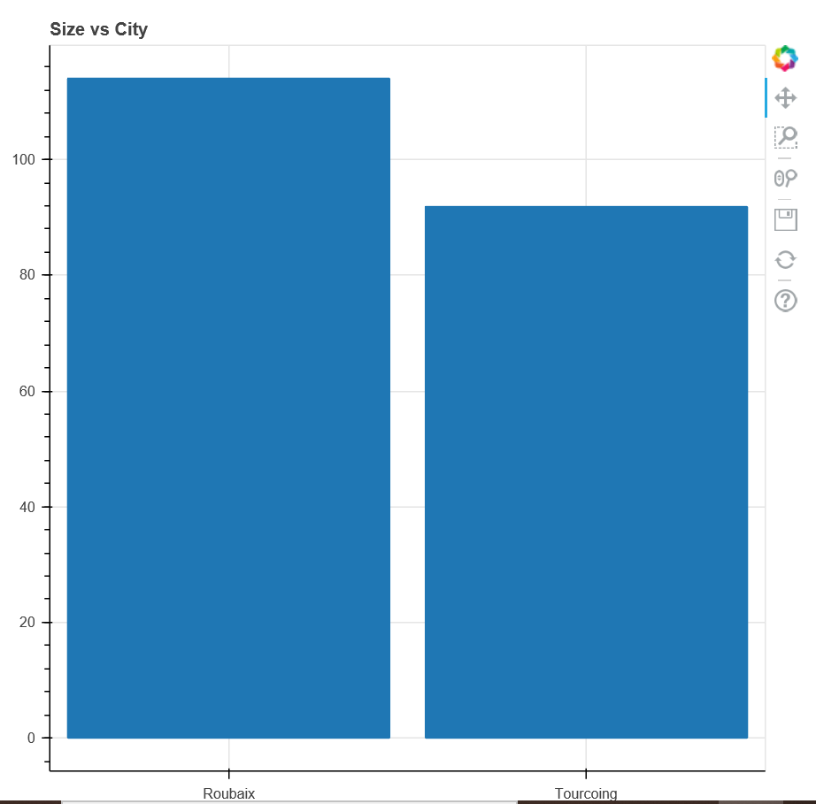
Which City offers bigger Units SIZE?
If you are looking for bigger Appartments, then Roubaix is a better choice. But the price will be higher as well.

Slide 17
04
Insights & Recommendations

Slide 18
Insights and Recommendations for future Improvements
01
02
02
04
04
03
Scrapp more pages for more accuracy over a longer period of time
Input data such as income level at the corresponding cities to see correlation with Prices. For example does a high income level affect the house prices
One issue that I overcame during the process was exporting the web scrapped data to excel sheets always lead to wrong formats

Slide 19
THANK YOU

